Slide 1
Artificial Intelligence
Problem or Opportunity?
11-May-2023
Pradeep Hosabettu, Technical Director, Impressico Business Solutions Pvt Ltd

Slide 2
Objective:
to raise awareness in our employees about recent developments in the world of AI
orient ourselves for the rapidly-evolving future that awaits all of us

Slide 3
Agenda
Introduction and Background of AI
Current Trends
Challenges
Opportunities
What should we do in Impressico?

Slide 4
Introduction and Background
Machines thought incapable of learning even while AI was being developed
(Artificial) Neural Networks model after the brain - neurons, synapses (connections), information flow. And went beyond.
Earliest seeds of NNs planted in 1943 in a paper published that connected biological neural activity to boolean logic (0/1)
In Early days - importance of scale to neural networks and deep learning went largely unappreciated

Slide 5
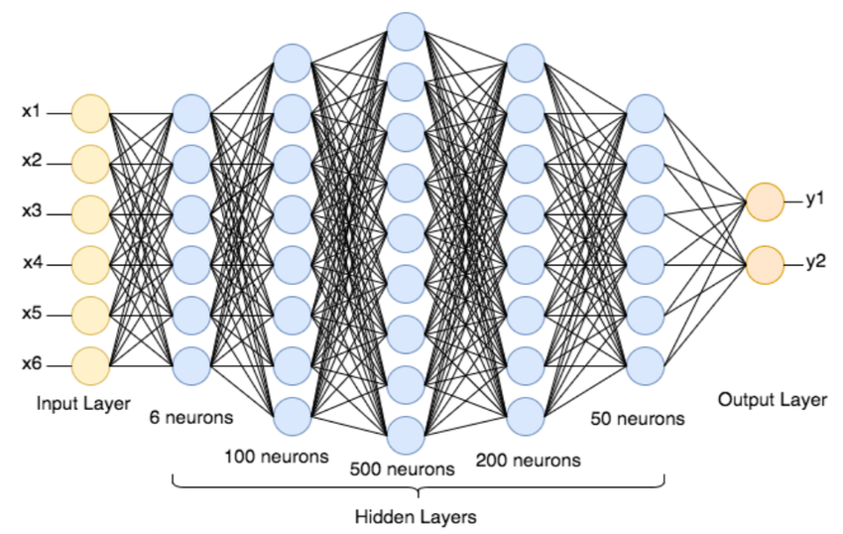
Introduction and Background (contd.)
Deep Neural Network Architecture
How does this NN help with deciding to go to the beach? (wave size, crowd size, recent shark attacks)

Slide 6
Introduction and Background (contd.)
Assign weights to every connection
Add biases to the input summation
Use functions to decide what/if information is transmitted to another node in the network
Weights, Biases, (and activation functions) constitute the “parameters” of a model - recent large models have 175B of them!
“Hidden” Layers help bring non-linearity and complexity to NNs (example of recognizing a church from an image)
A larger number of hidden layers constitutes a deep learning NN

Slide 7
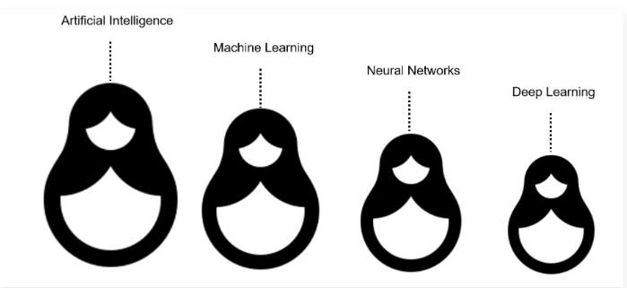
Introduction and Background (contd.)
AI/ML/NN/deep learning - how are they related?
AI is the broadest term for mimicking human intelligence
ML models that don’t implement a NN are usually limited to structured data input only, require considerably more human involvement in training and preparing the model

Slide 8
Introduction and Background (contd.)
Major types of NN
RNN (Recurrent) - feedback loops to store and “remember” from previous inputs. Allowed temporal dependencies and context to be built. Google recently (2017) created advancements and the result came to be called “transformers”. Think conversational bots
GAN (Generative-Adversarial) - as name suggests there are two parts which learn from each other to form a virtuous cycle of optimization. Think image synthesis, content creation

Slide 9
Current Trends
Recent advances in NNs owed to improvements in:
Scale: very large, very deep
Optimizations: both in training and in self-learning (backpropagation)
Combining: the recent star of AI, Large Language Models (LLMs) combine Generative (GAN) and Transformer (RNN) models
GAN providing the “creative” capability - what should be the next word?
Transformer providing the “attentive” capability to remember relationships and context
Multimodal: not just text, but images, and soon videos
Net result are multimodal LLMs with 175B parameters (weights, biases), upto 48 layers, with 1T connections!

Slide 10
Current Trends (contd.)
Generative LLM neural nets out there
Microsoft’s openAI (chatGPT) family of models
Google’s PaLM 2
Meta’s LLaMA
NVIDIA’s NeMo
Amazon’s TITAN FM
Bloomberg GPT
and more

Slide 11
Current Trends (contd.)
Open Source and Free
Cerebras-GPT
Dolly
chatGPT clones
Hugging Face’s BLOOM
StableLM
openLLaMA
MPT
and more

Slide 12
Current Trends (contd.)
Code generation models - already being used today!
Code generation
Code review
Code documentation
Code completion
Web Application builders
Text to SQL

Slide 13
Current Trends (contd.)
Code generation models - key players
OpenAI’s GPT-4 (exposed via code generator prompt plugins)
GitHub’s Copilot
Hugging Face’s StarCoder
CodePal
Codeium
CodeWhisperer (Amazon)
and more

Slide 14
Current Trends (contd.)
May the source be with you! (StarCoder ™)
Prompts ecosystem is developing on its own - fully leverage LLM capabilities with effective prompt generation via text and instruction (Prompt Engineering) - learning resources available
Thriving Plug-in and extension ecosystem around LLMs has emerged
Like having coding superpowers
Most integrate effortlessly into IDEs
Expect deeper integrations in the near future (e.g. springBoot)

Slide 15
Current Trends (contd.)
More advancements on the way!
Capability to learn from more sources is growing rapidly opening up more data to be digested for pre-training by large models
GPT-4 added images
Videos should come along soon - a development that can enrich their learning with the physics of movement in the real world
Audio as well

Slide 16
Challenges
Technical
Reliability, Quality issues - progress is continuously being made. However, there will be a trust deficit for the near-medium term
No tangible research output on safety, compliance, transparency technologies
No tangible efforts on standardization, metrics, frameworks to evaluate and benchmark what will inevitably be a glut of AI offerings in the near future

Slide 17
Challenges (contd.)
Ethical Issues
mind- reading with fMRI scan - a non-intrusive way to map brain activity readings to thought (expressed in text)
Geoffrey Hinton (“godfather of AI”) quit Google to be able to speak out on the many risks of its rapid rise in recent years (for a deep insider such as him to be genuinely concerned should make one ponder about what’s coming and how soon)
Reasoning abilities are getting better (e.g. GPT-4) - Ilya (lead scientist at openAI’s example of guessing the killer’s name). What does it mean for the biological human?

Slide 18
Challenges (contd.)
Safety Issues
The learning capabilities of neural networks are orders of magnitude higher scale than the human network - the doctor experience example.
Now think manipulation!
Again, Geoffrey Hinton worries about “catastrophic misuse”, “existential risks”, “economic risks”, “military applications”, “bad actors” - humans have a abysmal track record of handling even slow-creeping crises such as climate change, or gun violence (USA)
Is there a learning data plateau in sight that can curtail the steep ascent of AI learning? - Ilya and Geoffrey have overlapping and differing views

Slide 19
Challenges (contd.)
Social
Many companies have signalled intent to freeze hiring or cut jobs in anticipation of AI use (e.g. IBM support functions)
Jobs Impact Reports have come out. In the list of “high exposure” to risk are included writers/authors, mathematicians, etc. Also in the list, programmers, web developers, blockchain engineers!
Critical-thinking and reasoning skills are not at risk, but repetitive work is at risk
Multiplier effect - entry-level programming skills may disappear
Deepen inequalities and propagate biases
New tech brings new features and experiences with which governments and regulators are unprepared to deal
Huge Productivity increases - think non-linear. What could that mean?

Slide 20
Opportunities
Health - drug discovery, disease diagnosis & understanding of pathology, medical procedures
Transportation - intelligent traffic mgmt, autonomous tech
Justice and Law - faster resolution, even prediction, preemption
Resource Mgmt - fine-grained control over resources such as water, electricity, climate, food for sustainability
Quality of Life - higher standard of living at lower cost due to widespread availability of AI

Slide 21
Opportunities (contd.)
Employment
New Jobs focused on harnessing and applying AI
Elimination of repetitive tasks for humans allowing for greater satisfaction
Multiplier Effect - existing developers get a free shadow resource!

Slide 22
What should we do in Impressico?
Why does this concern us? (hint: we’re in the business of software services 😀 )
Two broad areas of impact
New Business Opportunities
Services Business Competitiveness

Slide 23
What should we do in Impressico? (contd.)
New Business Opportunity
Wider acceptance of AI is not just imminent, it’s happening now
Traditional obstacles to rapid adoption are being worked out faster - e.g. data security
New obstacles to adoption are giving way to benefits - e.g. job losses yielding to higher functional productivity
Every engineer at IBS should educate themselves on:
Identifying areas within projects that could benefit from AI - regular research (e.g. code interpreter’s data analytics results)
applying AI
Discuss / vocalize about AI opportunities in scrums, status calls and generally spread awareness

Slide 24
What should we do in Impressico? (contd.)
Services Business Competitiveness
Software development is set to undergo a sea change
It has already begun
Coding superpowers are available now, ignoring them will put our business at a severe disadvantage vis-a-vis the competition - do not let that happen
Research on, take decisions for, and incorporate code generator and ancillary AI tools to 2x, 3x, 4x your development output
Do this at a project or even practice level - example, .NET team may need to identify a different copilot for their IDE etc
Learn optimizations and prompts to get the best out of them - do not wait
Talk to managers and peers about best practices and socialize across your teams
Incorporate the gains into your estimations for new features and any development activities

Slide 25
In Summary..
AI advances in the last few years and 2023 in particular are not a transient phenomenon - the promise of half a century has come to fruition
It affects those in the knowledge economy significantly more than the rest of the world
Don’t panic - Stay ahead of it!

Slide 26
Thank you for your attention and Impressico looks forward to your eager involvement!

Slide 27
References
DeepAI
A logical calculus of the ideas immanent in nervous activity (csulb.edu)
(PDF) The perceptron: a probabilistic model for information storage and organization in the brain | Cristian Carabali - Academia.edu
https://www.youtube.com/watch?v=XjSUJUL9ADw
https://www.theguardian.com/technology/2023/may/01/ai-makes-non-invasive-mind-reading-possible-by-turning-thoughts-into-text
https://www.visualcapitalist.com/cp/which-jobs-artificial-intelligence-gpt-impact/
https://youtu.be/sitHS6UDMJc
https://www.deeplearning.ai/short-courses/chatgpt-prompt-engineering-for-developers/

